Slide 1
Engineering Notebooks
FIRST Tech Challenge
2018 Season Kick-Off

Slide 2
What’s the purpose of the Engineering Notebook?
One of the GOALS of FTC is to recognize the engineering design process and the journey that a team makes.
Problem definition
Concept design, system-level design, detailed design
Test and verification
Production of the robot
Protection of intellectual property

Slide 3
What should it include?
This is your documentation of your robot design & team development. It should record ALL time spent doing research, outreach, team meetings, & plans for growth.
It should include:
Sketches (on graph paper…not a napkin!)
Discussions & team meetings
Design evolution
Software development…your programming
Processes & obstacles
EACH team member’s thoughts throughout the journey of the season

Slide 4
What are judges looking for?
Judges use your engineering notebook to get a better understanding of the journey your team has taken throughout the season ~ developing your team, designing and building your robot & promoting FIRST.
Include obstacles,
Lessons learned,
Drawings on paper…INCLUDE the math and science used
The notebooks are there to track your team’s progress from the beginning of the season throughout competition season.

Slide 5
Engineering Notebook Guidelines
The front cover MUST have your team name AND number.
Binders can’t be greater than 3 inches & you can’t submit more than two notebooks to judges at competition.
Attach a one page team summary to the inside front cover.
Summary narrative about the team
Bullet highlights from your season (EX: professionals you worked with, type of outreach, how many people did you impact with outreach, veteran teams need to highlight any new growth or direction the team has taken)
“…include the team number & list of pages in the EN (you) would most like the judges to consider.” (FIRST revision 1.1: 01.09.2018)

Slide 6
Engineering Notebook Guidelines
EN’s MUST be divided into the following sections.
Engineering section (required)
The robot design process with a note written for each meeting.
Where to put your sketches, CAD drawings, build pics, programming info.
Team Section (required)
Information about your team and outreach activities.
A Business Plan, Strategic Plan or Sustainability Plan (NOT required, BUT strongly recommended)

Slide 7
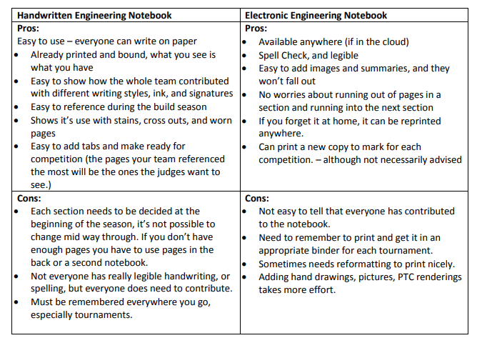
Adapted from “All About the Engineering Notebook” created by the University of Idaho 4H Extension.

Slide 8
Additional Pointers
Blue or black ink only.
It’s okay to misspell. Strike through the misspelling and move on to the next word…NO liquid paper.
A team member should sign each note.
You want the EN to be so detailed that a person could sit down to look at it and see exactly how to build your robot and the thought it took to get there.
LABEL your programming code.
Use the EN to show how you changed your robot between competitions and why you chose to change it.
CITE!!! if another team’s robot inspired some part of your design!!!

Slide 9
Biggest Struggle with the Engineering Notebook
Attitude:
“I came here to build, not to write another paper.”
“Writing everything down gets in the way of my creativity.”
DON’T:
Assign just one person to complete the EN. Everyone needs to be a part of the documentation. However, one person can be in charge of making sure it gets done.
Put off documentation instead of doing it every meeting. Designs can change pretty quickly sometimes. You will loose needed information and get overwhelmed.

Slide 10
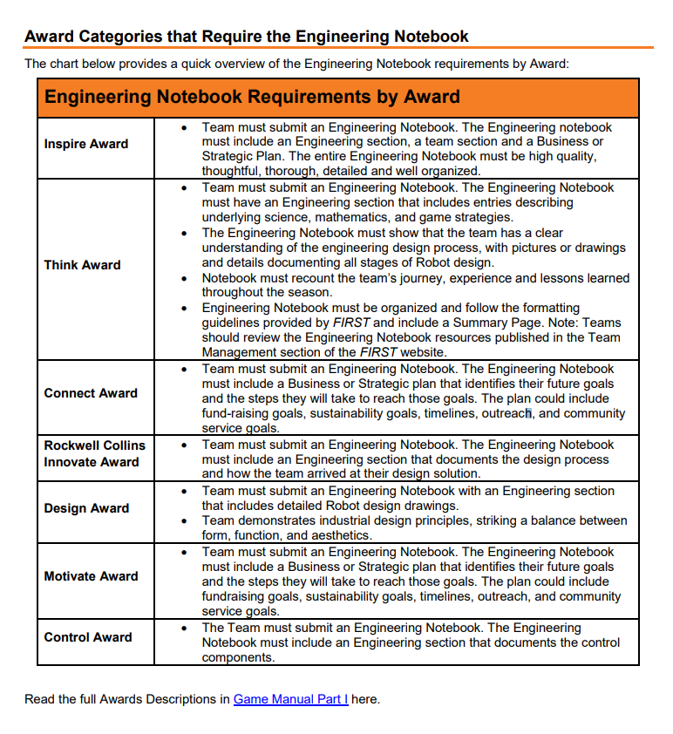
You need to flag “6-8” pages in your engineering notebook prior to leaving it with judges.
In choosing what to flag, take a look at the EN requirements by award.
Are there examples in your EN that exemplify these requirements? Flag the best of those entries that do.
This is also a great way to prepare for your judging session ~ organizing what you want to way to the judges.

Slide 11
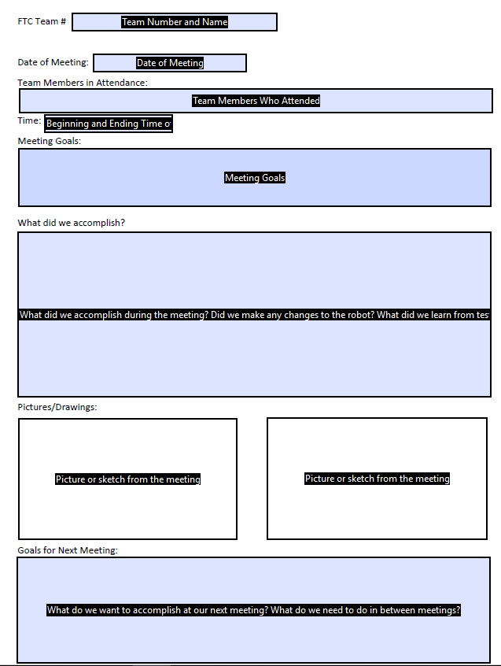
Engineering Note Example

Slide 12
Parts to add to your Business/Strategic Plan
Mission Statement & Team Goals
Projected Hours & Team Commitment
Budget
Fundraising/Sponsorship Plan
Recruitment
Training
Risks & Opportunities
Outreach Documentation & Recognition

